Slide 1
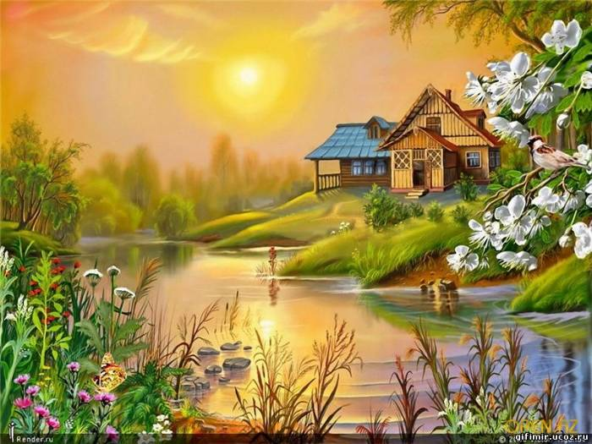
Find irregular verbs:
fly
live
shine
wash
grow
go
play
blow
swim

Slide 2
http://gif-deti.ucoz.ru/photo/detskie_kartinki_iz_multfilmov/32

